Slide 1

Null pointer exception
Team Members:
Mansi Agarwal (001376132)
Mitesha Jadhav(001306626)
Ziye lu(001688853)

Slide 2

HEL(P)ORT

Slide 3

Real facts
In past two weeks India has seen six heinous acts which are not acceptable by humankind.
CHANGE IS WHAT WE NEED

Slide 4

Problem Definition
Built an application for helping rape and acid attacked victims

Slide 5
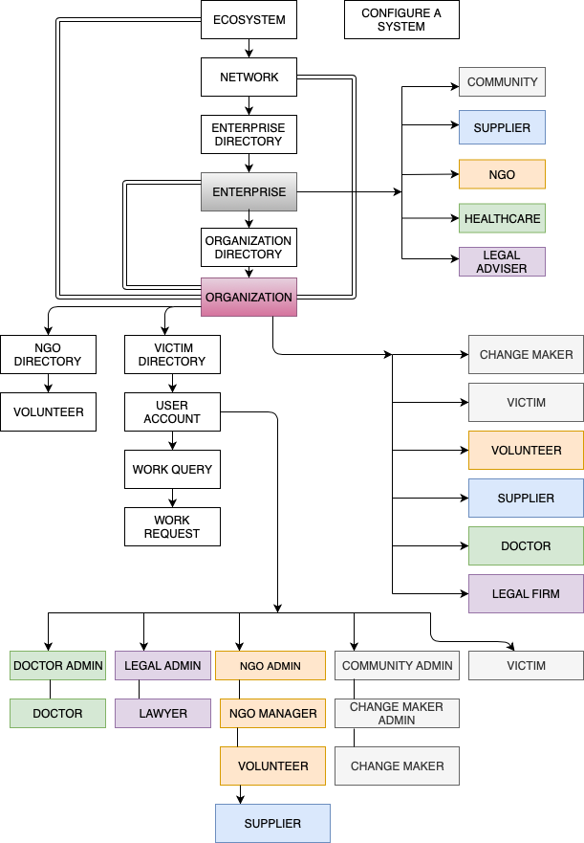
Eco-system

Slide 6
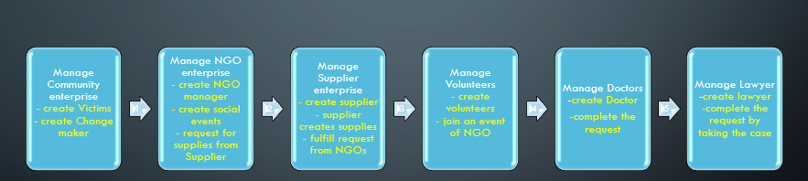
Use Case Diagram

Slide 7
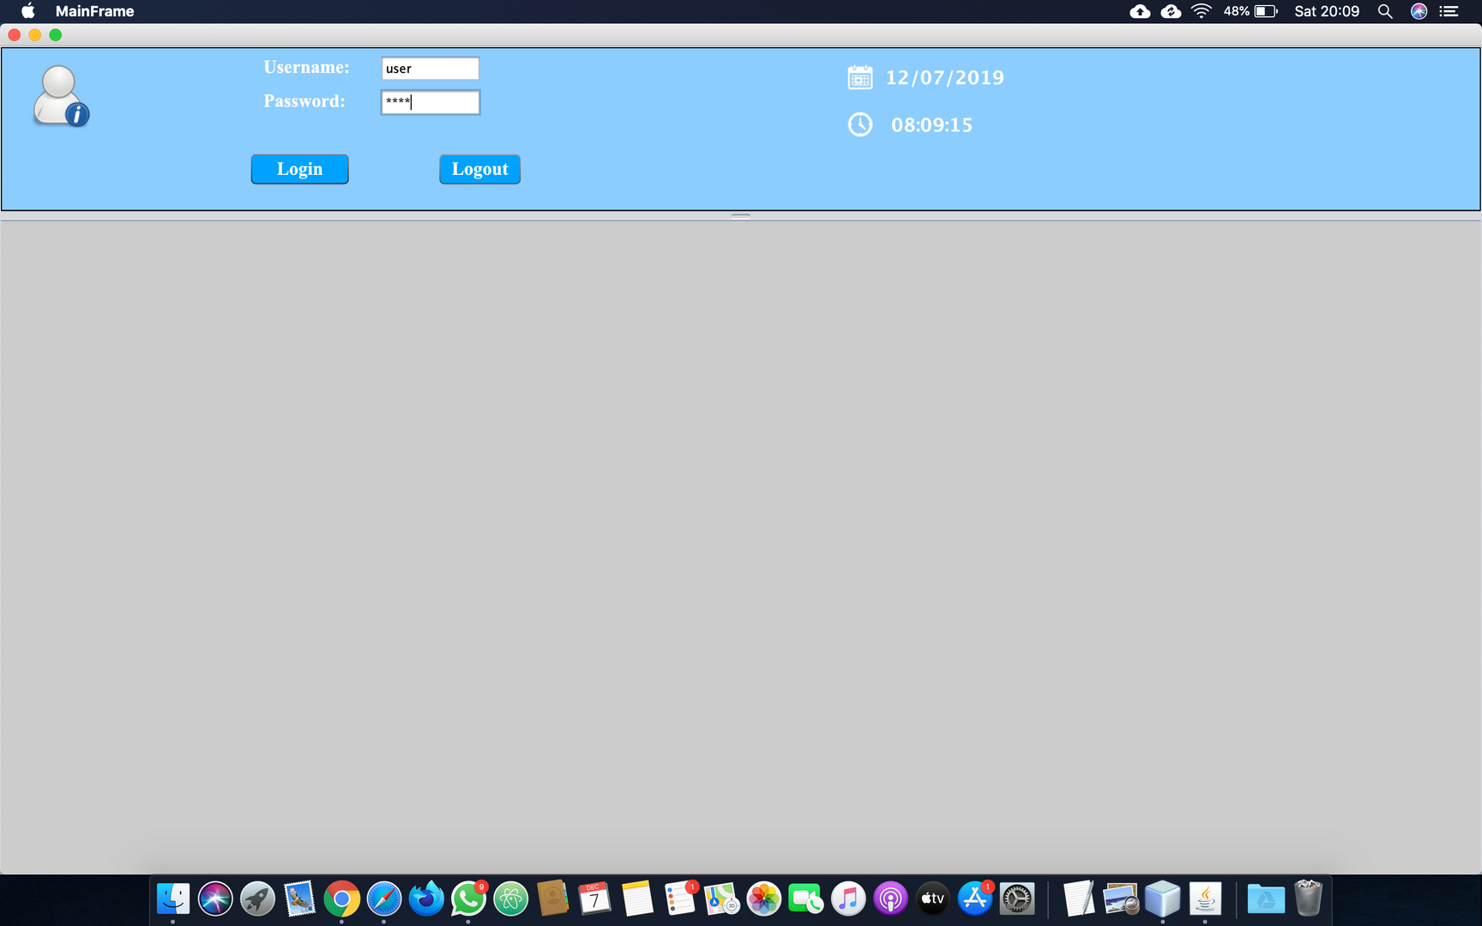
System Login

Slide 8

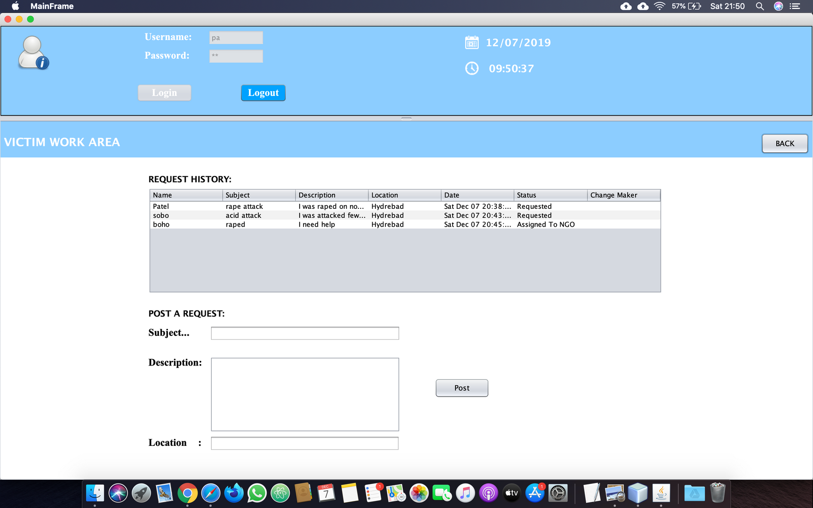

Victim Panel

Slide 9
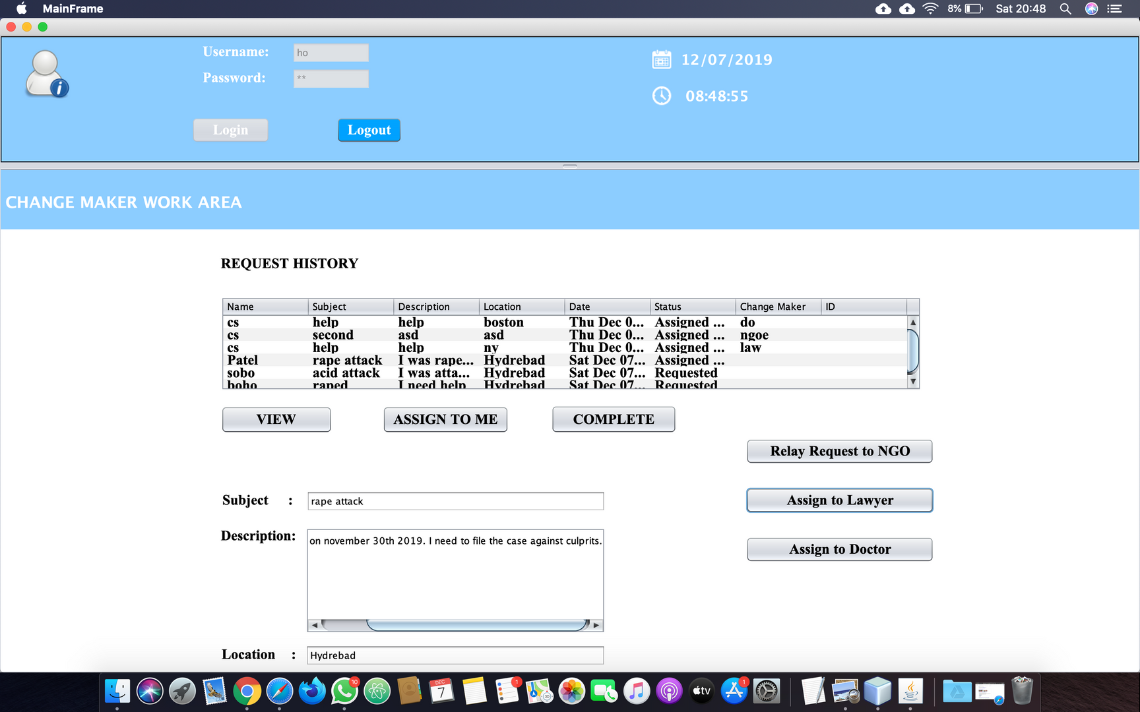
Change maker work area

Slide 10
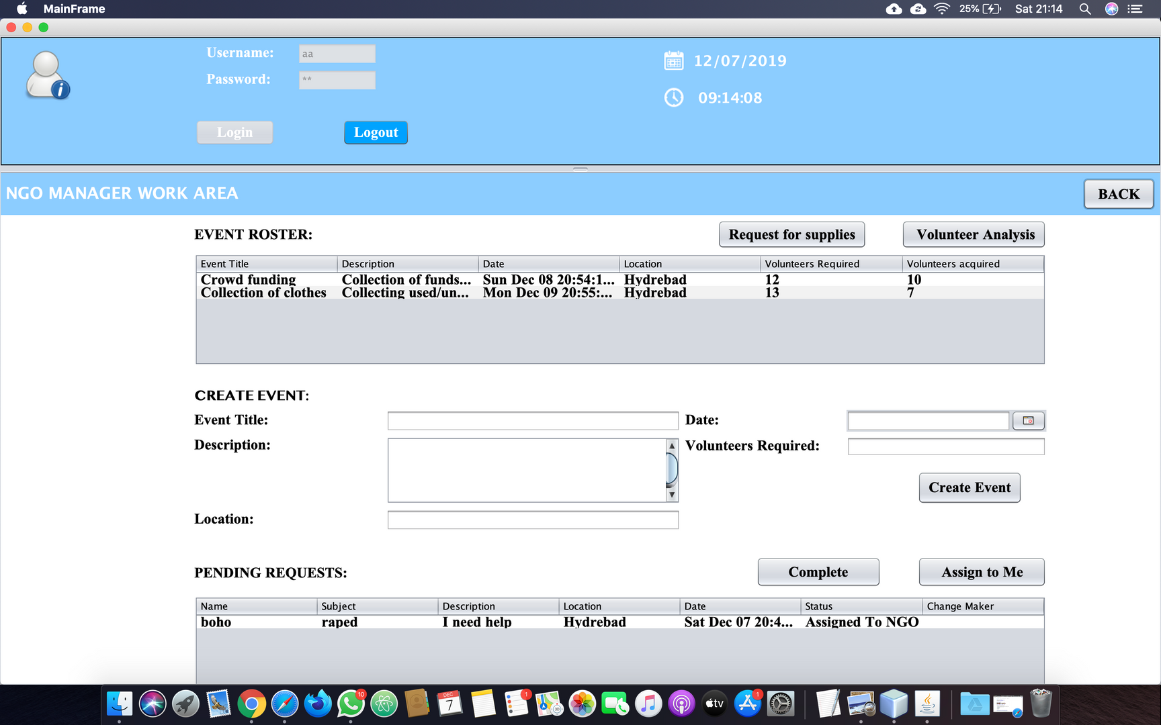
NGO Manager work area

Slide 11
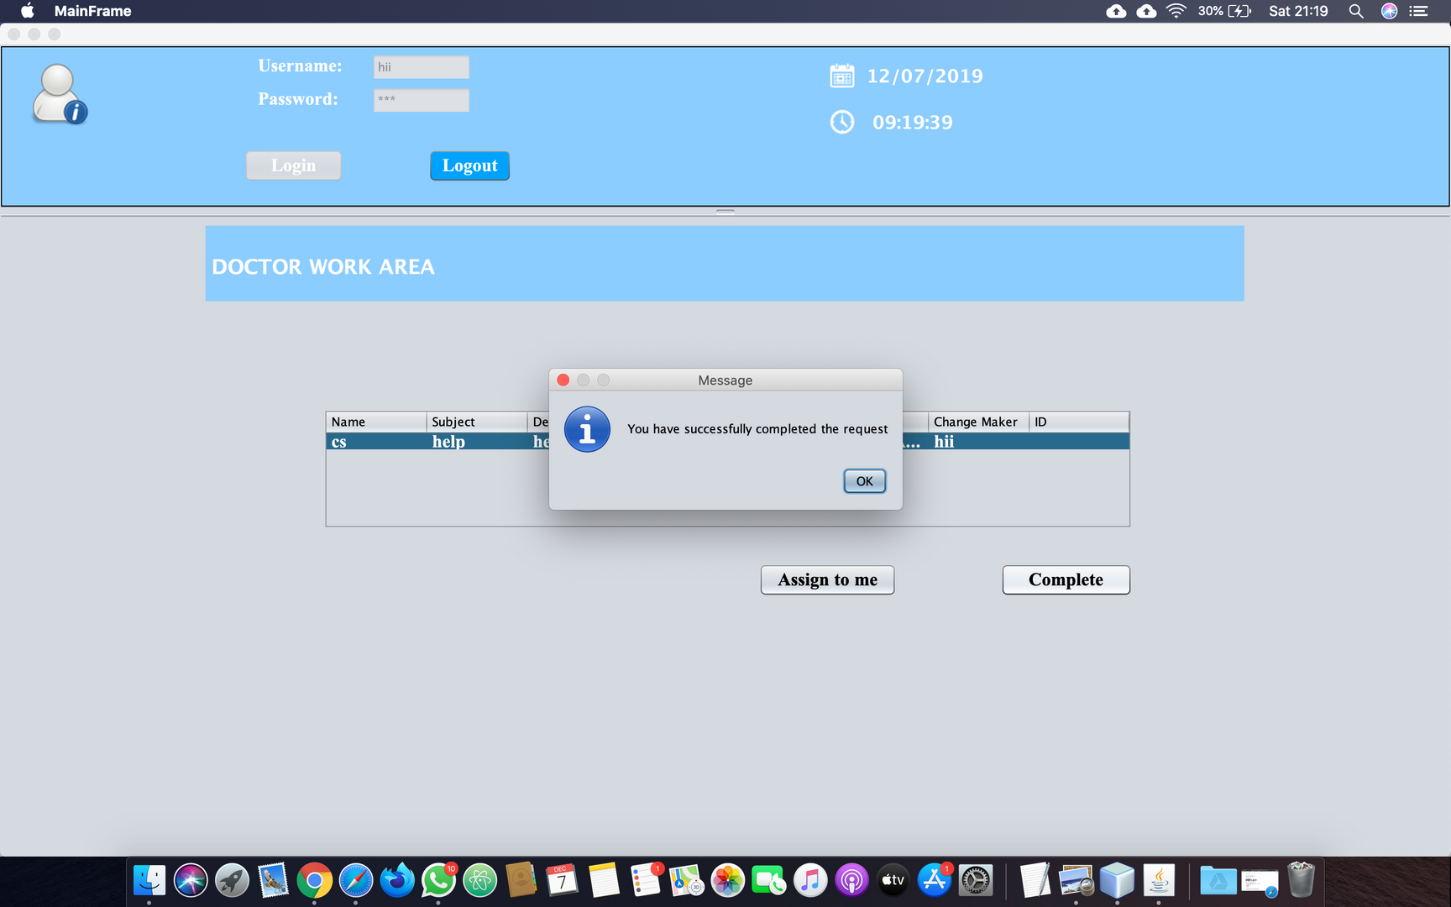
Doctor work area

Slide 12
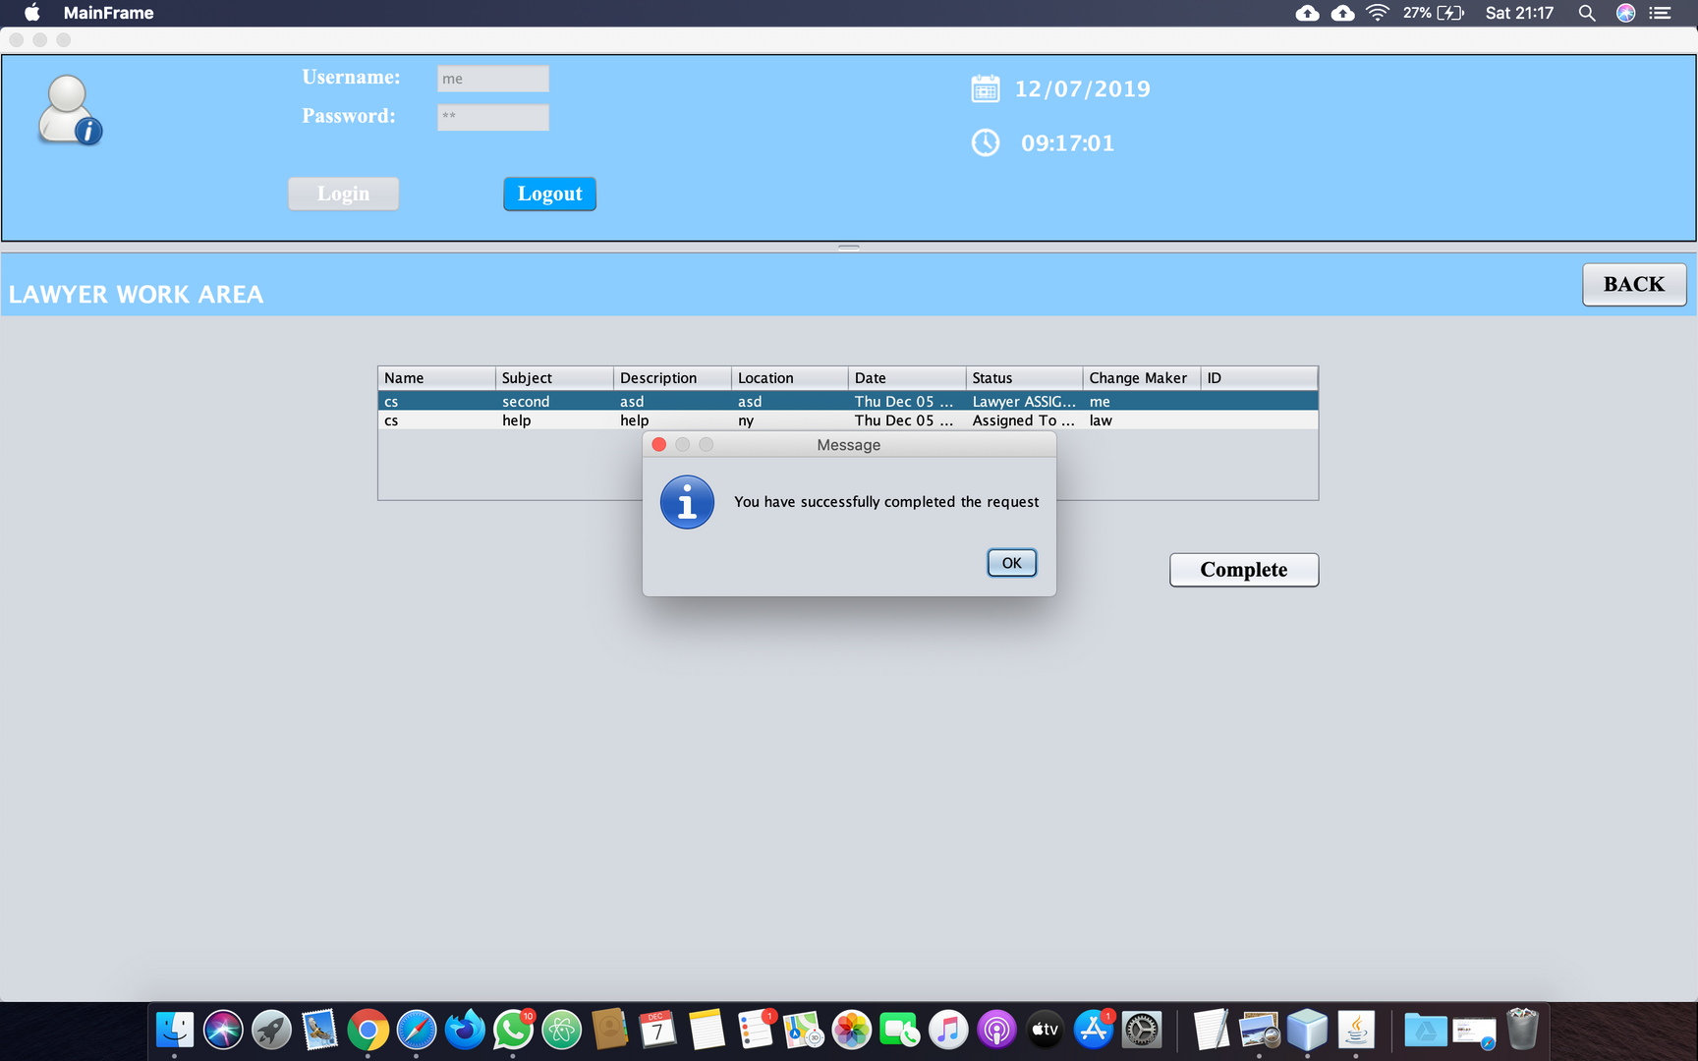
Lawyer work area

Slide 13
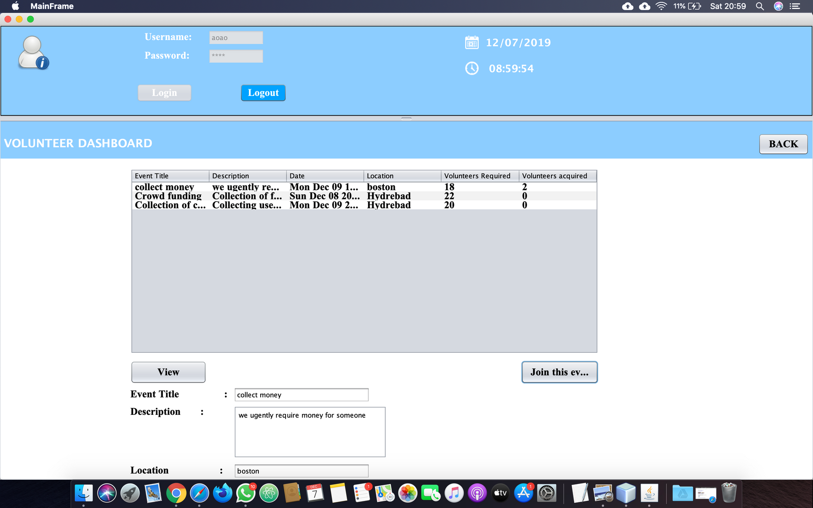
Volunteer Dashboard

Slide 14
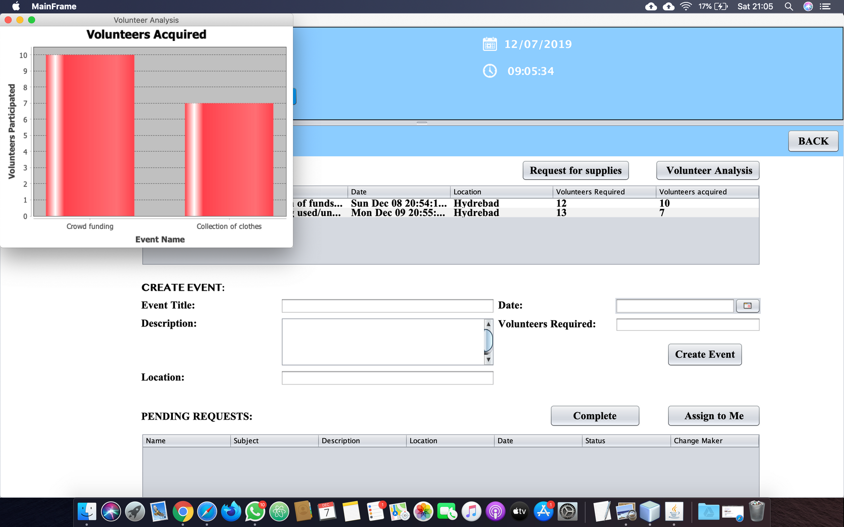
Volunteer Analysis

Slide 15
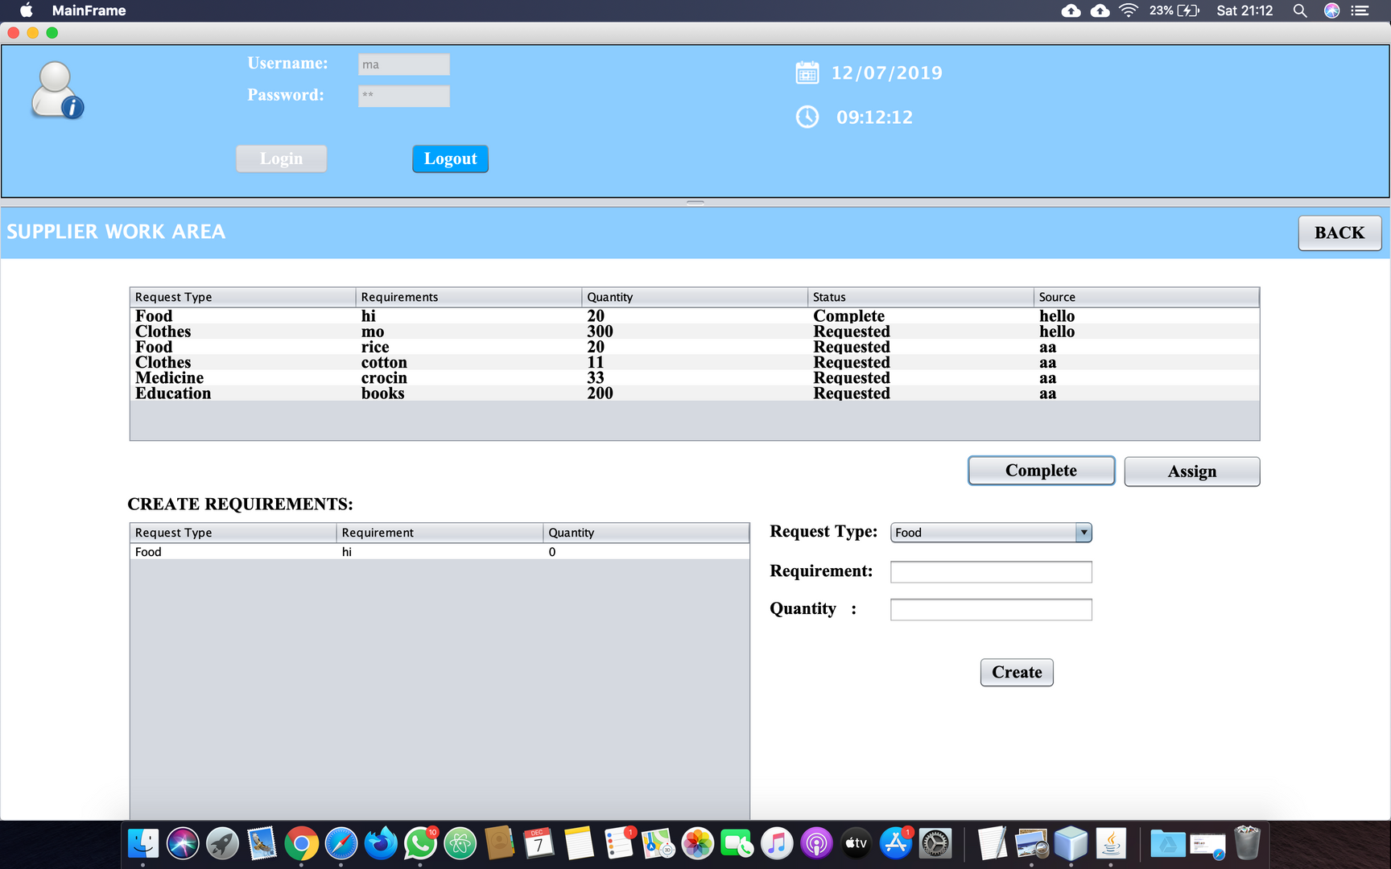
Supplier work area

Slide 16

THANK YOU!!
The first step for all new employees
MAKE THE CHANGE YOU WISH TO SEE IN THE WORLD

